Slide 1

Uniform Dispersion of Oblivious Mobile Robots on Alternate Nodes of an Infinite Grid
Group No: 20
Date: 2nd June 2026
Mentor By:
Dr. Sruti Gan Chaudhuri
Presented By:
Sudip Naskar
Subhadip Sinha
Subhas Chandra Shit
Roll No: 002211001131
Roll No: 002111001154
Roll No: 002211001130
Department: Information Technology
Department: Information Technology
Department: Information Technology

Slide 2

Table of Contents
01
Introduction
11
Future Scope
02
Problem Defination
12
Conclusion
03
Previous Work Overview
References
13
04
Robot Model & Assumptions
05
Previous Algorithm
06
Modified Algorithm
07
Illustrative Example
08
Simulation
09
Correctness
10
Use Cases

Slide 3

Introduction
Swarm robotics studies how multiple autonomous robots work together to achieve a common goal without centralized control or direct communication. In the previous work, a distributed algorithm was proposed to uniformly scatter robots on alternate nodes of a two-dimensional grid.
The robots are autonomous, anonymous, and memoryless, and they operate using the Look–Compute–Move cycle, where they observe their surroundings, decide their next action, and then move accordingly. The system assumes an infinite grid environment where robots occupy grid nodes, move along grid edges, and share common directions without communicating with each other.
Using simple local rules under a semi-synchronous execution model, the algorithm successfully achieves a collision-free, deadlock-free, and uniformly distributed robot arrangement.

Slide 4


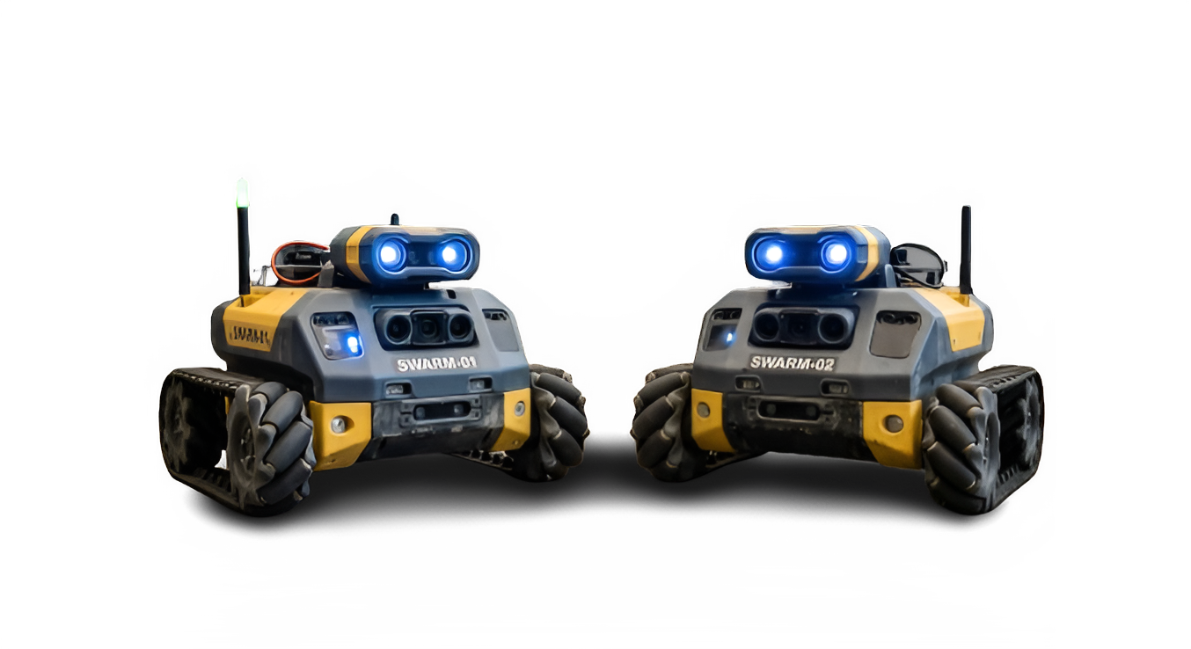


Problem Definition
Robots are initially placed at arbitrary positions on a two-dimensional grid.
There is no guarantee that the robots are evenly spaced or well organized.
The robots are autonomous, anonymous, and have no memory of past actions.
They cannot communicate with each other and rely only on observation.
The objective is to uniformly scatter the robots on alternate nodes of the grid.
The solution must avoid collisions and deadlock and converge in finite time.

Slide 5
Previous Semester Work

Slide 6

Previous Work Overview
Previous Research:
The work focuses on organizing multiple autonomous robots on a two-dimensional grid.
Robots are initially placed at arbitrary positions.
The objective is to distribute robots uniformly on alternate grid nodes.
Robots operate without direct communication or centralized control.
The algorithm ensures collision-free and deadlock-free movement.
Convergence to the final formation is achieved in finite time.

Slide 7
Robot Model & Assumptions
Robot Characteristics
Execution Cycle
Autonomous and identical robots.
Anonymous (no unique IDs).
Oblivious (no memory of previous actions).
Unlimited visibility of the grid.
Movement restricted to grid edges only.
Robots follow the Look–Compute–Move cycle
Look: observe positions of all robots on the grid
Compute: decide the next move based on the observation
Move: execute the computed movement
The system follows a semi-synchronous (SSYNC) model, where a subset of robots is activated simultaneously in each round

Slide 8
System framework
Environment
Infinite two-dimensional grid
Robots initially placed at distinct nodes
Grid nodes are uniformly spaced
Robots occupy only grid nodes at any time
Agreements
Common X-axis and Y-axis directions
No shared global origin
No unique robot identifiers
No direct communication between robots

Slide 9
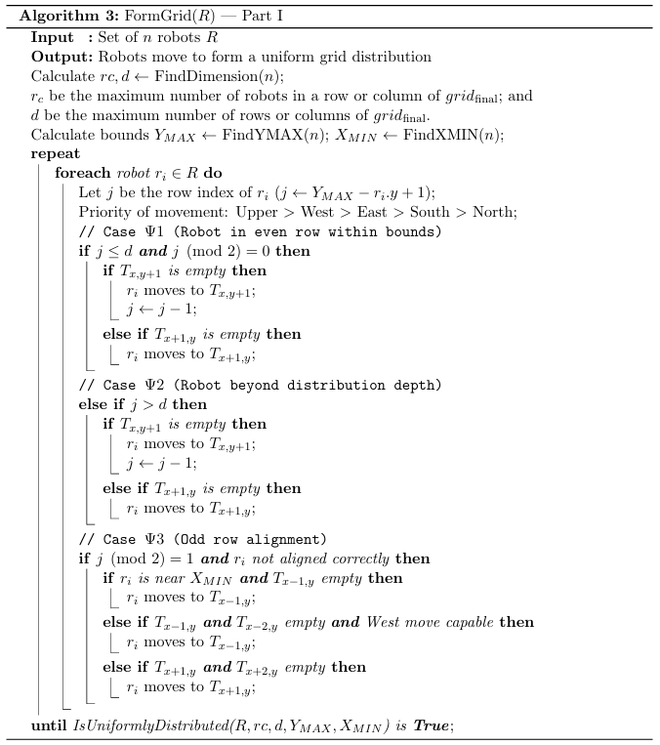
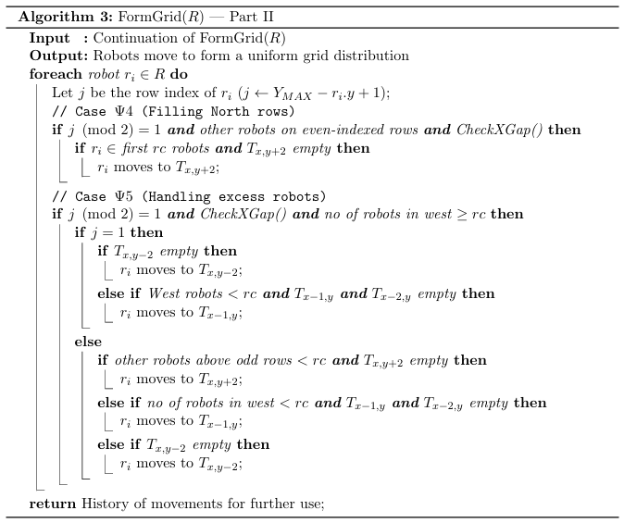
MAIN Algorithm

Slide 10

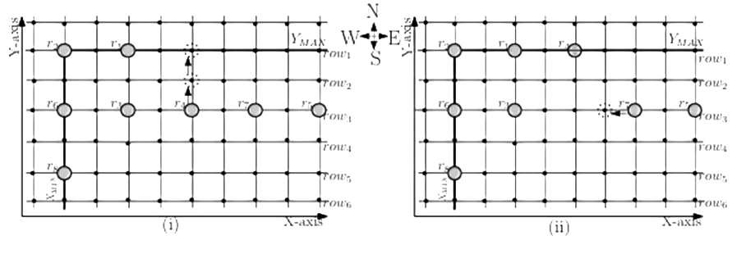
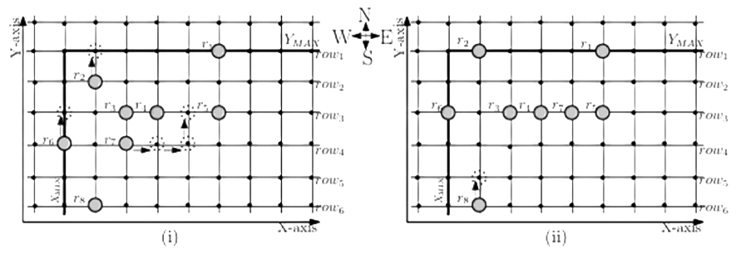
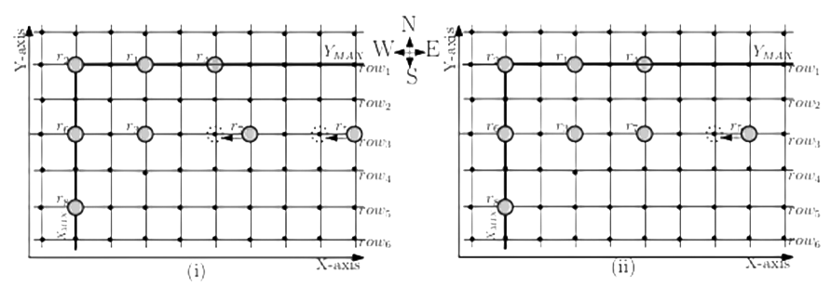
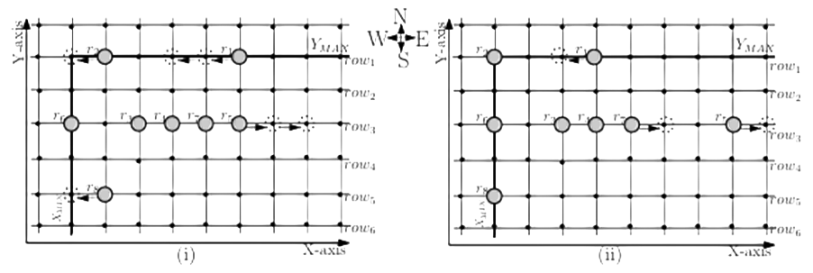
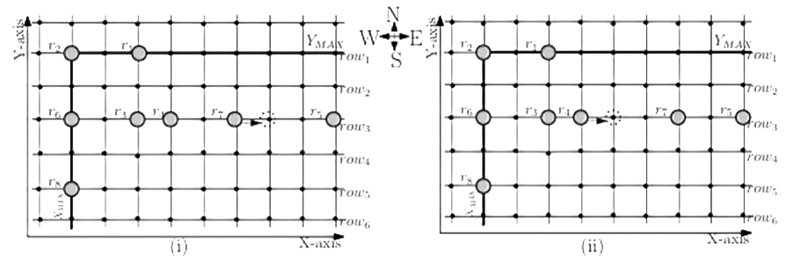
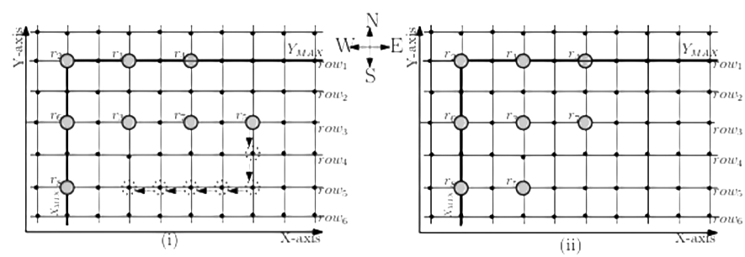
Fig: 1
Fig: 4
Fig: 2
Fig: 5
Fig: 3
Fig: 6

Slide 11
This Semester Work

Slide 12









Supporting Algorithms
$$FindYMAX (n)$$
$$FindXMIN(n)$$
$$FindDimension(n)$$
$$CheckXGap()$$
$$IsUniformlyDistributed(R,rc,d,YMAX,XIMN)$$

Slide 13
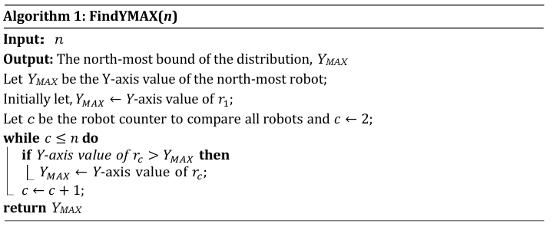
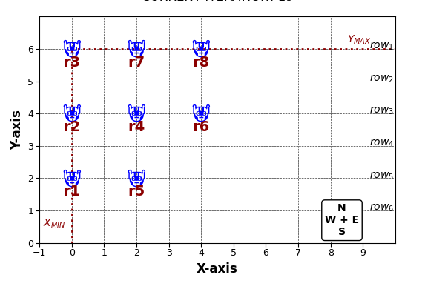
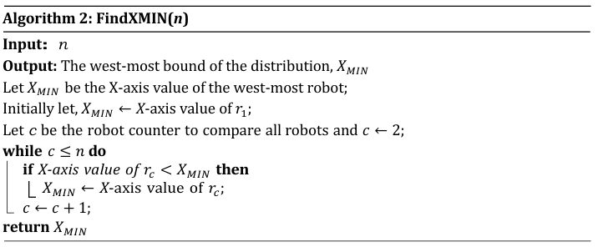
Supporting Algorithms

Slide 14
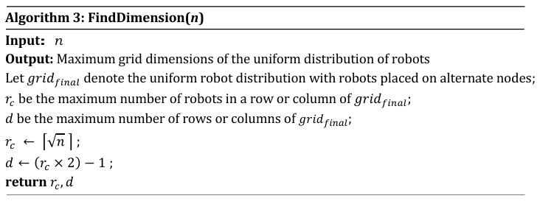

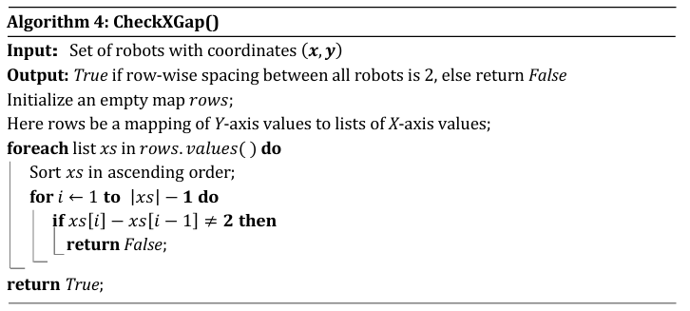
Supporting Algorithms

Slide 15
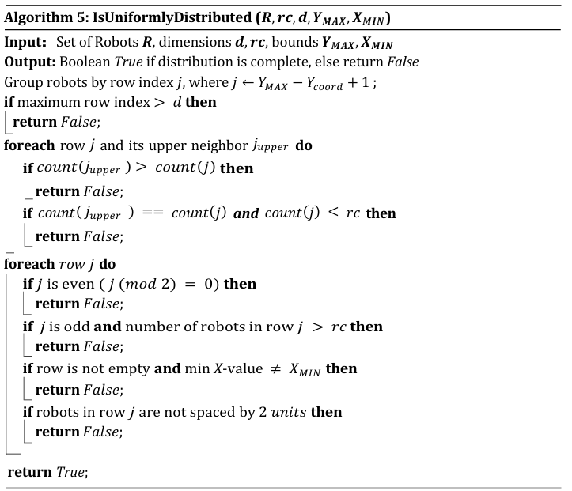

Supporting Algorithms

Slide 16
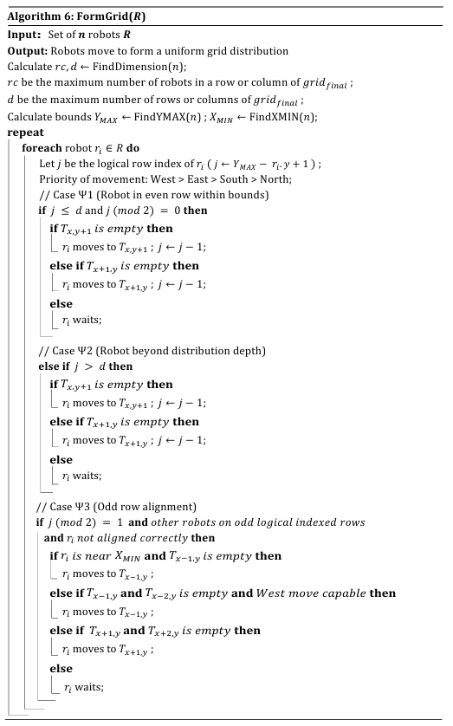
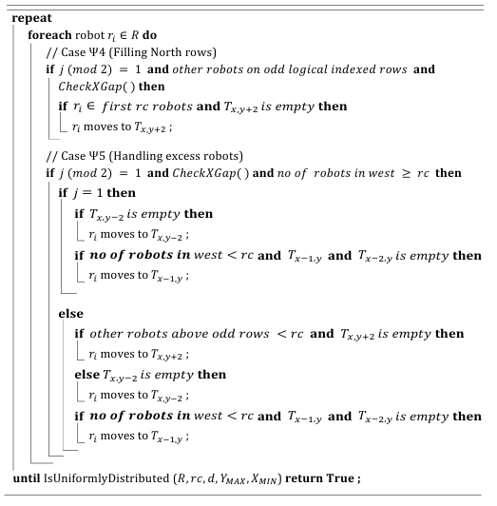
Modified Main Algorithm

Slide 17
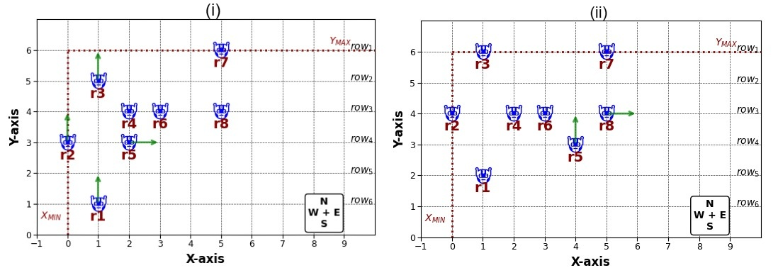
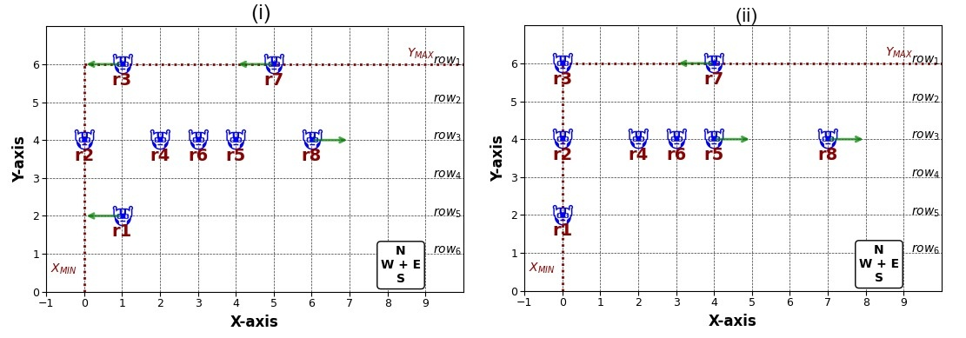
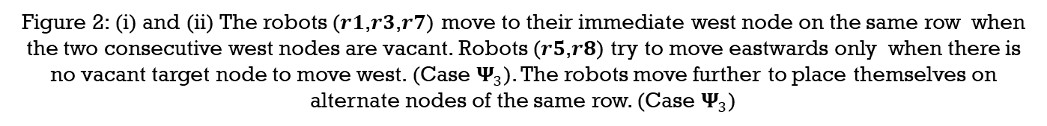
Illustrative Example
Figure 1: (i) The robots on the even rows move northwards to the odd rows of 𝒈𝒓𝒊𝒅𝒇𝒊𝒏𝒂𝒍. (Case ${\text{Ψ}}_{1}$) and since 𝒓𝟏 is beyond the first 𝒅 (i.e. (𝟑 × 𝟐) − 𝟏 = 𝟓) rows from $Y_{MAX}$, so it moves northwards to the 5th row. (Case ${\text{Ψ}}_{2}$)
Figure 2: (i) and (ii) The robots (𝒓𝟏,𝒓𝟑,𝒓𝟕) move to their immediate west node on the same row when the two consecutive west nodes are vacant. Robots (𝒓𝟓,𝒓𝟖) try to move eastwards only when there is no vacant target node to move west. (Case ${\text{Ψ}}_{3}$). The robots move further to place themselves on alternate nodes of the same row. (Case ${\text{Ψ}}_{3}$)

Slide 18
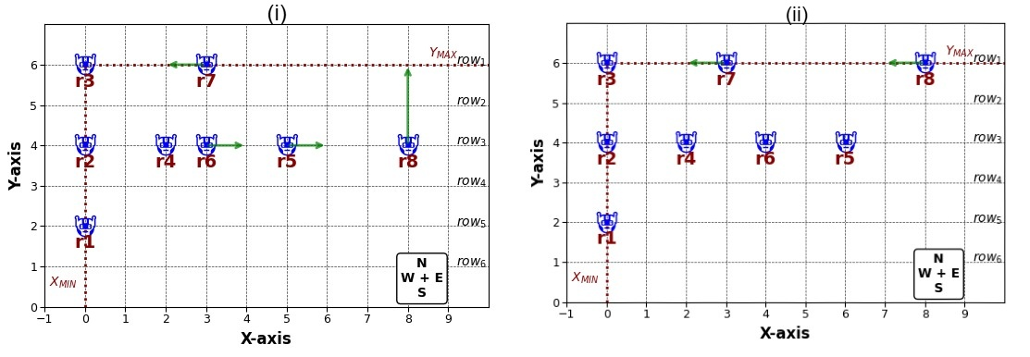
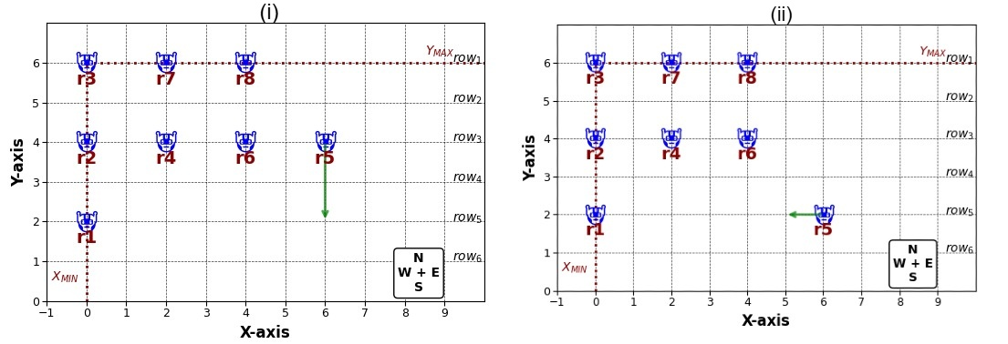
Illustrative Example
Figure 3: (i) The robot, 𝒓𝟖 ∉ first 𝒓𝒄 robots of 𝒓𝒐𝒘𝟑, also moves northwards to the alternate row, 𝒓𝒐𝒘𝟏, as it finds a vacant node. (Case ${\text{Ψ}}_{5}$) (ii) Robot 𝒓𝟕 and 𝒓𝟖 in 𝒓𝒐𝒘𝟏 again continue to hop west, since it again finds consecutive vacant nodes on its west. (Case ${\text{Ψ}}_{3}$)
Figure 4: (i) Robot 𝒓𝟓 in 𝒓𝒐𝒘𝟑 has 𝒓𝒄 robots on its west in 𝒓𝒐𝒘𝟑 and the above odd row 𝒓𝒐𝒘𝟏 has 𝒓𝒄 robots. (Case ${\text{Ψ}}_{5}$). So, 𝒓𝟓 moves southwards to alternate row, 𝒓𝒐𝒘𝟓 (ii) Then robot 𝒓𝟓 moves westwards to place itself on an alternate node of the grid distribution.

Slide 19
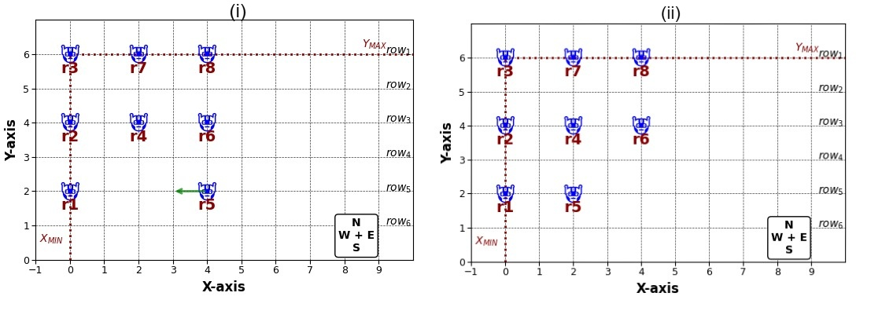
Illustrative Example
Figure 5: (i) Then Robot 𝑟5 again move westwards to place itself on an alternate node of the grid distribution. (ii) A uniform distribution along the grid (𝑔𝑟𝑖𝑑𝑓𝑖𝑛𝑎𝑙.) is formed, with robots on alternate nodes of this grid distribution.

Slide 20


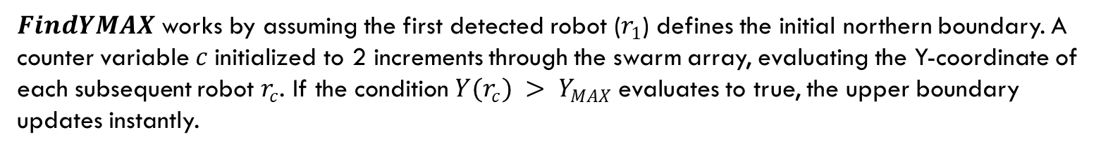
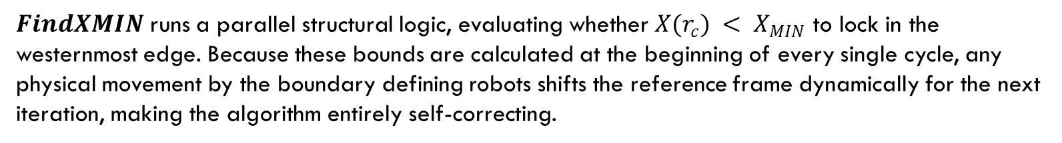
Algorithms Implementation Mechanics
$FindYMAX$ works by assuming the first detected robot ($r_{1}$) defines the initial northern boundary. A counter variable$c$ initialized to 2 increments through the swarm array, evaluating the Y-coordinate of each subsequent robot $r_{c}$. If the condition $Y(r_{c}) > Y_{MAX}$evaluates to true, the upper boundary updates instantly.
$FindXMIN$ runs a parallel structural logic, evaluating whether $X(r_{c}) < X_{MIN}$ to lock in the westernmost edge. Because these bounds are calculated at the beginning of every single cycle, any physical movement by the boundary defining robots shifts the reference frame dynamically for the next iteration, making the algorithm entirely self-correcting.

Slide 21
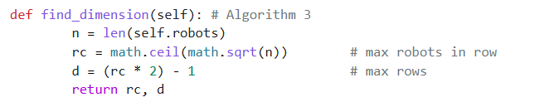
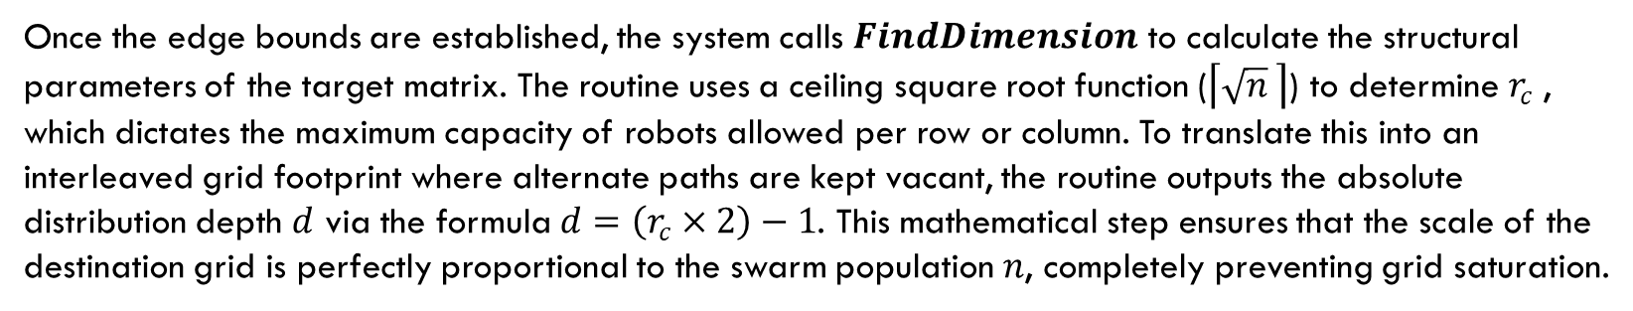
Algorithms Implementation Mechanics
Once the edge bounds are established, the system calls $FindDimension$ to calculate the structural parameters of the target matrix. The routine uses a ceiling square root function ($\left\lceil \sqrt{n} \right\rceil$) to determine $r_{c}$, which dictates the maximum capacity of robots allowed per row or column. To translate this into an interleaved grid footprint where alternate paths are kept vacant, the routine outputs the absolute distribution depth $d$ via the formula $d=\left(r_{c}×2\right)−1$. This mathematical step ensures that the scale of the destination grid is perfectly proportional to the swarm population $n$, completely preventing grid saturation.

Slide 22
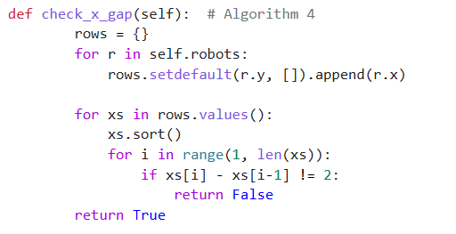
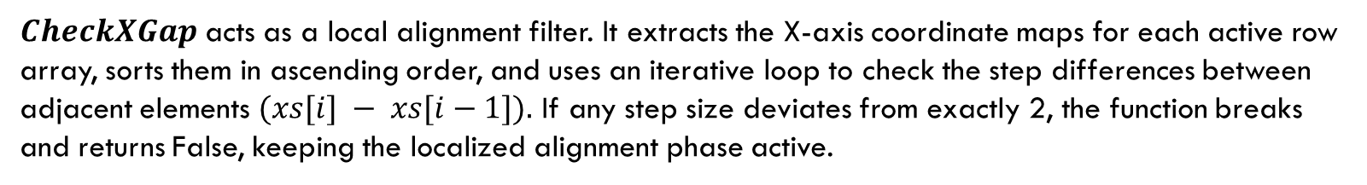
Algorithms Implementation Mechanics
$CheckXGap$ acts as a local alignment filter. It extracts the X-axis coordinate maps for each active row array, sorts them in ascending order, and uses an iterative loop to check the step differences between adjacent elements $(xs[i] − xs[i−1]).$ If any step size deviates from exactly 2, the function breaks and returns False, keeping the localized alignment phase active.

Slide 23
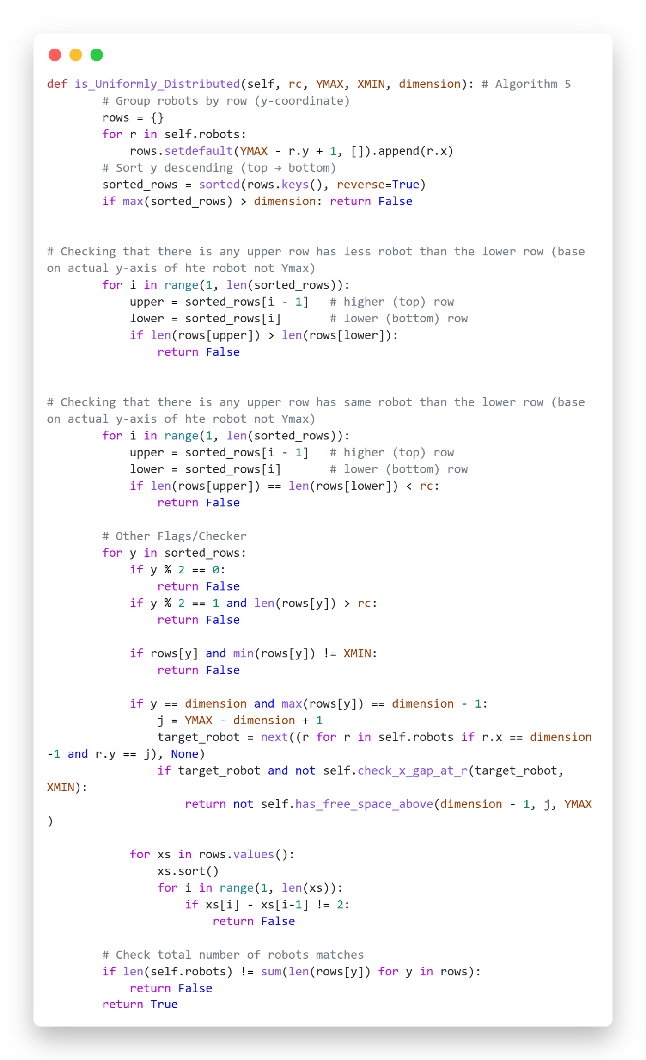
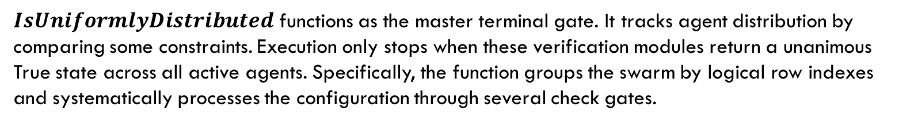
Algorithms Implementation Mechanics
$IsUniformlyDistributed$ functions as the master terminal gate. It tracks agent distribution by comparing some constraints. Execution only stops when these verification modules return a unanimous True state across all active agents. Specifically, the function groups the swarm by logical row indexes and systematically processes the configuration through several check gates.

Slide 24
Simulation
The algorithm was implemented in Python 3.10 and visualized using the Matplotlib library on a 2D grid.
Robots were initially placed at random positions. They identified the XMIN and YMAX boundaries and then moved toward the target alternate-node configuration.
Collision avoidance was ensured by allowing movement only when the target node was vacant and by following movement rules Ψ₁ – Ψ₅.
The simulation showed successful uniform scattering, with robots reaching a stable configuration in approximately 20 execution cycles without collisions or deadlocks.

Slide 25
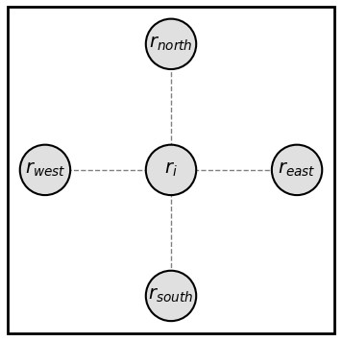
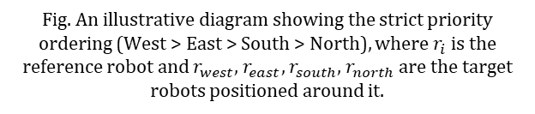
CORRECTNESS
Lemma 1. The movement of robots is collision-free.
Proof 1: Two situations could potentially cause a collision:
1. Obstacle on Edge
Robots occupy only grid nodes, not edges.
2. Target Conflict
Multiple robots may attempt to move toward the same
vacant node.
A strict priority order is used:
West > East > South > North
This priority ensures that each robot selects a unique destination. No two robots compute the same target node.
3. Semi-Synchronous (SSYNC) Scheduling
While a robot is moving, other robots are not in the observation (Look) phase.
Robots always make decisions using a consistent grid configuration.
This prevents incorrect movement decisions based on outdated information.
Fig. An illustrative diagram showing the strict priority ordering (West > East > South > North), where $r_{i}$ is the reference robot and $r_{west}$, $r_{east}$, $r_{south}$, $r_{north}$are the target robots positioned around it.

Slide 26

CORRECTNESS
Lemma 2. The Algorithm is Deadlock-Free.
Case 1 (Ψ₁)
Robot moves North or East until it reaches an odd row.
Each move brings it closer to the target row.
No repeated actions occur.
Case 2 (Ψ₂)
Robot moves North or East until it reaches row d.
The distance to the target decreases with every move.
Progress is always guaranteed.
Case 3 (Ψ₃)
Robot moves West if the node is vacant; otherwise, it moves East.
Since the grid is infinite toward the East, a vacant node will always be available.
Therefore, no robot can become permanently blocked.
Case 4 (Ψ₄)
Robot moves directly to a designated alternate row.
It does not stop at intermediate positions.
This prevents deadlock during row transitions.
Case 5 (Ψ₅)
Robot moves to an alternate row (North or South).
The algorithm ensures that sufficient vacant nodes exist.
Every robot is guaranteed a valid destination.
Theorem 1: A set of autonomous, oblivious, identical mobile robots can disperse on alternate nodes on an infinite grid under semi-synchronous scheduling, starting from any arbitrary configurations, executing a finite number of activation cycles.

Slide 27

Use cases
Surveillance & Area Monitoring Ensures complete and non-overlapping coverage of the target area.
Military and Border Patrolling Autonomous robots can be deployed for patrolling sensitive regions with minimal human presence.
Agricultural Robotics Provides equal spacing for planting, spraying, and crop monitoring.
Disaster Response Operations Supports systematic and collision-free robot deployment in unknown terrains.

Slide 28
Future scope
Asynchronous Execution Model
Obstacle-Aware Scattering
Adapt the solution for a fully asynchronous (ASYNC) environment, making it more practical for real-world deployment.
Extend the model to support obstacles or irregular terrains within the grid environment.
Fault Tolerance
Dynamic Environment Handling
Modify the algorithm to handle robot failures or malfunctioning robots without affecting the final grid formation.
Enable robots to re-scatter automatically when new robots are added or existing robots are removed.

Slide 29

conclusion
This work presents an effective distributed algorithm for achieving uniform scattering of autonomous robots on alternate nodes of a two-dimensional grid. By relying solely on local observations and the Look–Compute–Move cycle, the robots organize themselves without centralized control or communication.
The algorithm ensures safe and efficient robot deployment by preventing collisions and deadlocks while guaranteeing convergence in finite time. The results demonstrate the potential of swarm robotics in creating organized formations and improving area coverage, making it suitable for applications such as surveillance, environmental monitoring, agriculture, and disaster management.

Slide 30

references
M. Mondal, S. G. Chaudhuri, and P. Chatterjee, “Uniform Scattering of Robots on Alternate Nodes of a Grid,” Department of Information Technology, Jadavpur University, Kolkata, India.
M. Dorigo and E. Şahin, “Swarm Robotics – A Review,” Springer, 2004.
S. Das, P. Flocchini, G. Prencipe, “Uniform Scattering of Robots on a Grid,” Proceedings of the International Conference on Distributed Computing Systems, IEEE.

Slide 31
Any Questions?

Slide 32
Thank You for Listening

